Slide 1

AEM周末分享
第 96期
哈佛图书馆墙壁训言
AEM WEEKEND SHARING

Slide 2

AEM WEEKEND SHARING
此刻打盹，你将做梦；此刻学习，你将圆梦。
This moment will nap, you will have a dream; But this moment study,you will interpret a dream.

Slide 3
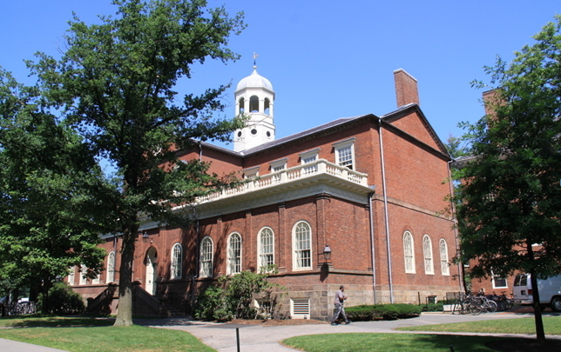
AEM WEEKEND SHARING
我荒废的今日，正是昨日殒身之人祈求的明日。
I leave uncultivated today, was precisely yesterday perishes tomorrow which person of the body implored.

Slide 4
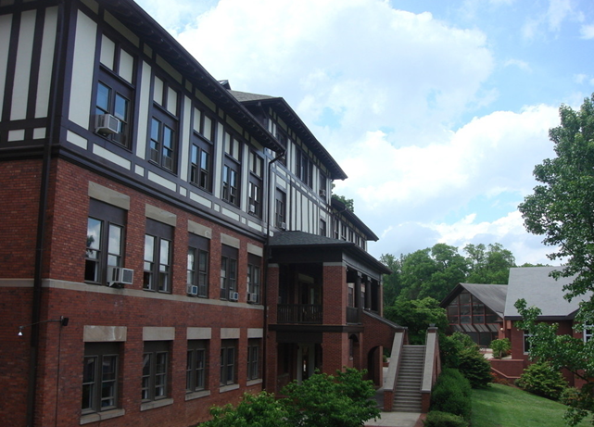
AEM WEEKEND SHARING
觉得为时已晚的时候，
恰恰是最早的时候。
Thought is already is late, exactly is the earliest time.

Slide 5

AEM WEEKEND SHARING
勿将今日之事拖到明日。
Not matter of the today will drag tomorrow.

Slide 6
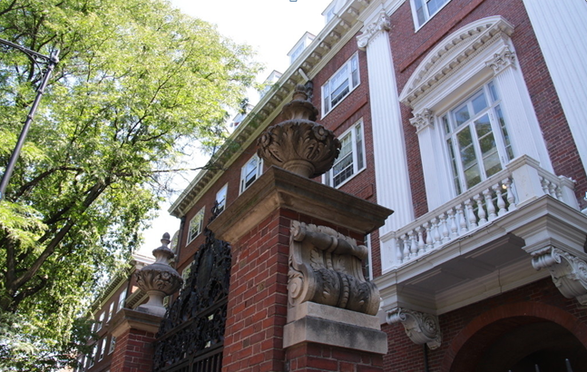
AEM WEEKEND SHARING
学习时的苦痛是暂时的，
未学到的痛苦是终生的。
Time the study pain is temporary, has not learned the pain is life-long.

Slide 7
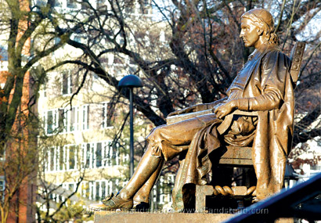
AEM WEEKEND SHARING
学习不是缺乏时间，
而是缺乏努力。
Studies this matter lacks the time, but is lacks diligently.

Slide 8
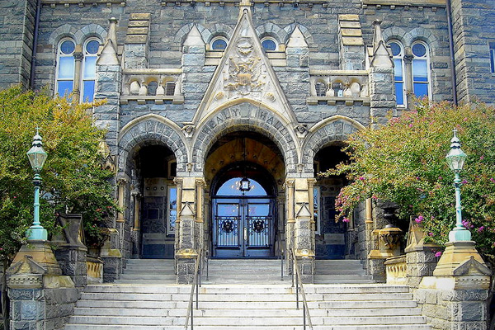
AEM WEEKEND SHARING
幸福或许不排名次，但成功必排名次。
Perhaps happiness does not arrange the position, but succeeds must arrange the position.

Slide 9
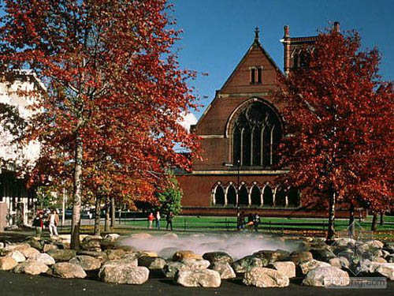
AEM WEEKEND SHARING
学习并不是人生的全部。但既然连人生的一部分也无法征服，还能做什么呢？
The study certainly is not the life complete. But, since continually life part of-studies also is unable to conquer, what but also can make?

Slide 10
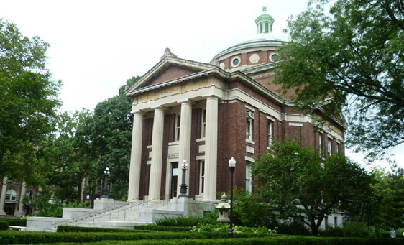
AEM WEEKEND SHARING
请享受无法回避的痛苦。
Please enjoy the pain which is unable to avoid.

Slide 11

AEM WEEKEND SHARING
只有比别人更早、更勤奋地努力，才能尝到成功的滋味。
only has compared to the others early, diligently diligently, can feel the successful taste.

Slide 12

AEM WEEKEND SHARING
谁也不能随随便便成功，它来自彻底的自我管理和毅力。
Nobody can casually succeed, it comes from the thorough self-control and the will.

Slide 13

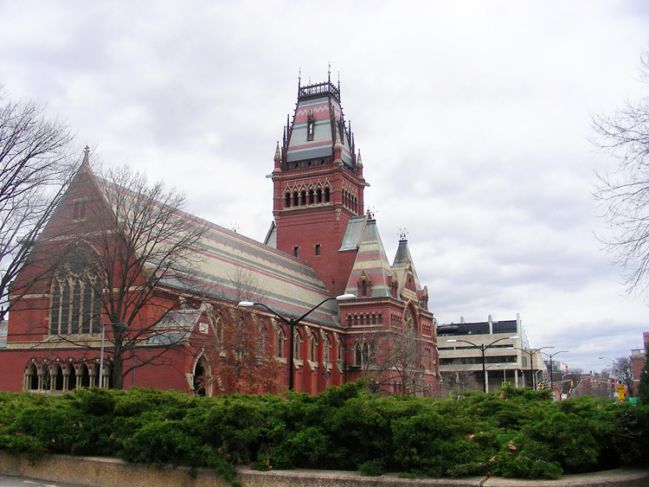
AEM WEEKEND SHARING
周末愉快！
共创 共进 共赢 共享
AEM科技人力资源部

