Slide 1


AEM WEEKEND SHARING
我们到底有多穷？
AEM周末分享
第 241 期

Slide 2
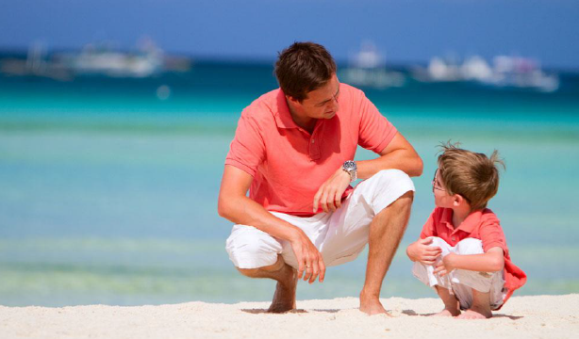
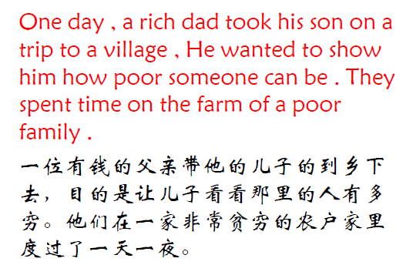
AEM WEEKEND SHARING

Slide 3

AEM WEEKEND SHARING
On their return from the trip,the father asked his son,
“How was the trip?”
“It was great ,dad.”
回去的时候，父亲问儿子：“这次旅行怎么样？”
“太棒了，爸爸！”

Slide 4
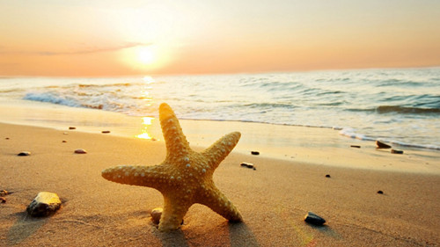
AEM WEEKEND SHARING
“Did you see how poor people live?” the father asked ,
“ Oh yes”, said the son.
“你终于看到这里的人有多穷了吧？”父亲问。“是啊！”

Slide 5

AEM WEEKEND SHARING
“So，tell me，what did you learn from the trip?” asked the father.
“那你有什么感想？”父亲问。

Slide 6
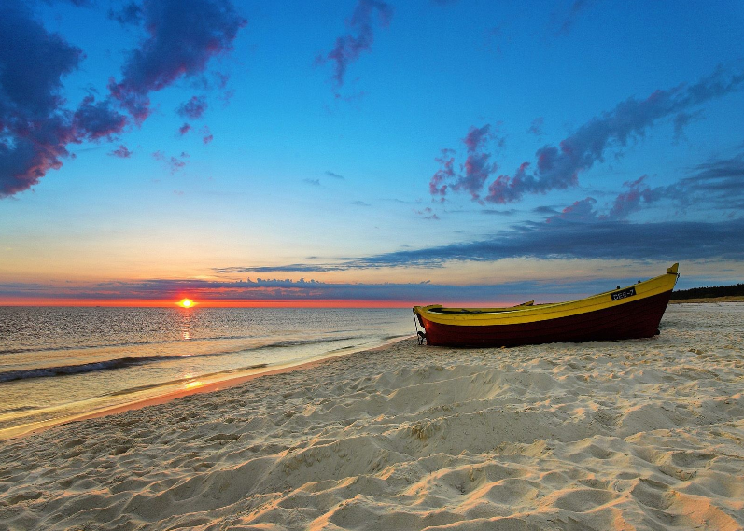
AEM WEEKEND SHARING
The son answered: We have one dog,
they have four. We have a pool,they have rivers.
儿子回答道：“我看到我们家有一只小狗，而他们家有四只。我们有一座池塘，而他们家有一条河。

Slide 7
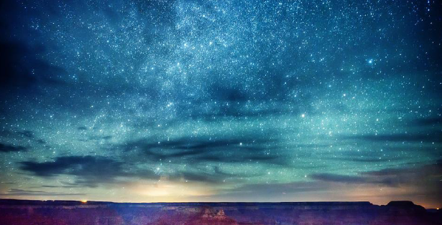
AEM WEEKEND SHARING
We have tube-lights at night,they have stars, We have walls to protect us, they have friends. We have television ,they spend time with family and relatives.
我们在花园里有进口的照明灯，而他们家有满天的繁星。我们有高墙保护我们，而他们有很多朋友。我们有电视看，他们则花时间和家人相处。

Slide 8
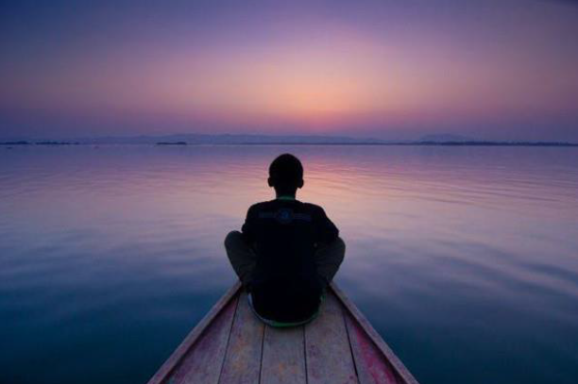
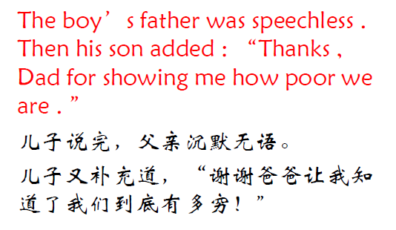
AEM WEEKEND SHARING

Slide 9

AEM WEEKEND SHARING
Moral of the Story:
It is not about money that makes us rich. Its simplicity love, compassion ,friendships,values,family that makes our lives rich.
这个故事的寓意：金钱并不能让我们变得富有，质朴的关爱，友情，家庭和积极的生活态度，才会使我们的生活变得富有。

Slide 10
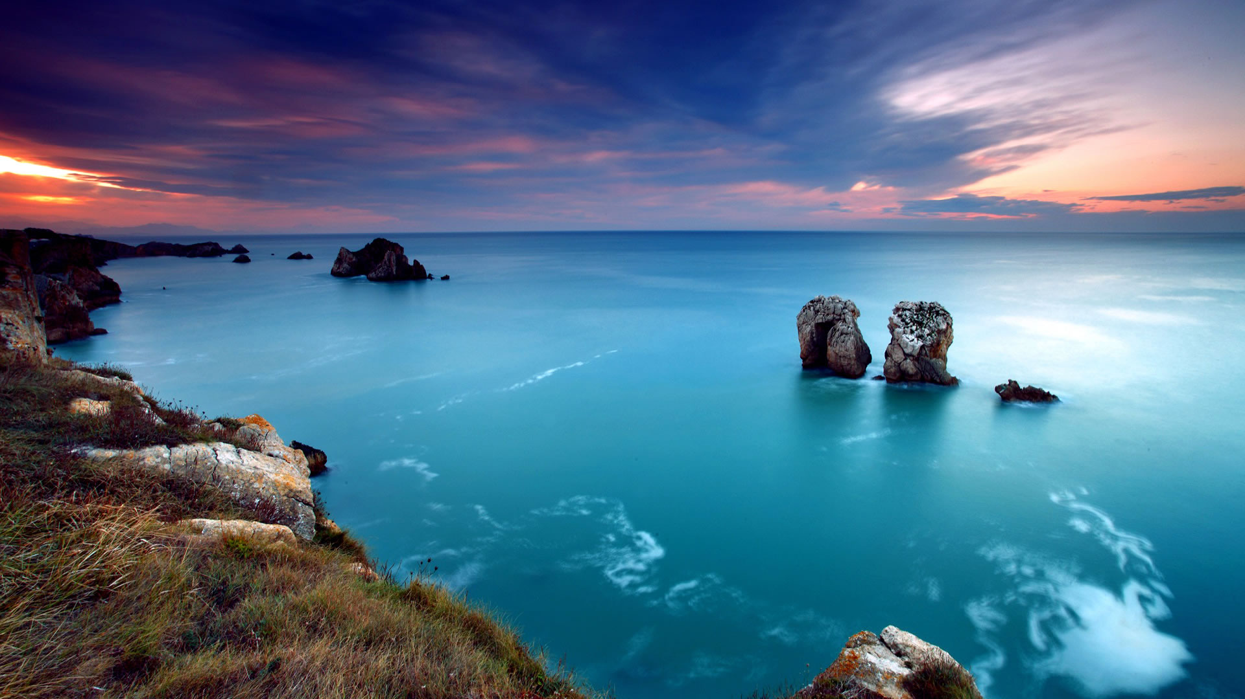
AEM WEEKEND SHARING
一个人弃如敞履的东西也许会成为另一个人的无价之宝，所有这一切都取决于你看问题的角度。如果你拥有了上述这些，你其实就拥有了一切！

Slide 11

AEM WEEKEND SHARING
周末愉快！
共创 共进 共赢 共享
AEM科技人力资源部

