Slide 1


AEM WEEKEND SHARING
AEM周末分享
第 238 期
把梳子卖给和尚
很高明？
是时候反思一下了!

Slide 2
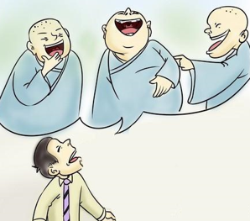
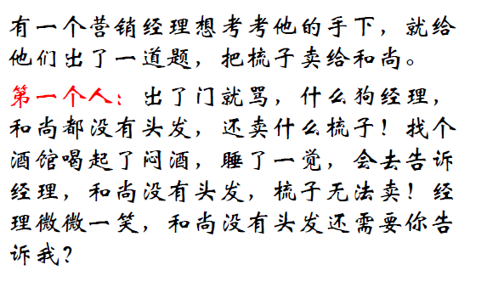
AEM WEEKEND SHARING

Slide 3
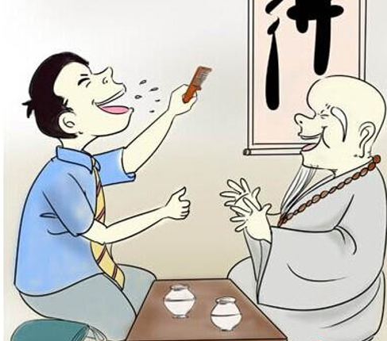
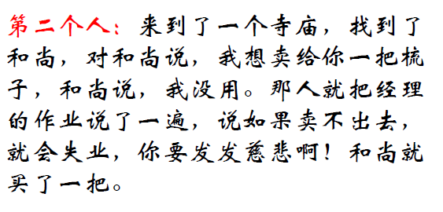
AEM WEEKEND SHARING

Slide 4
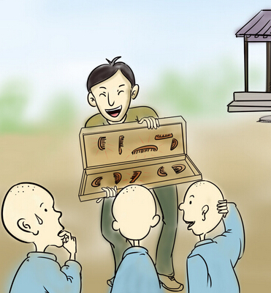
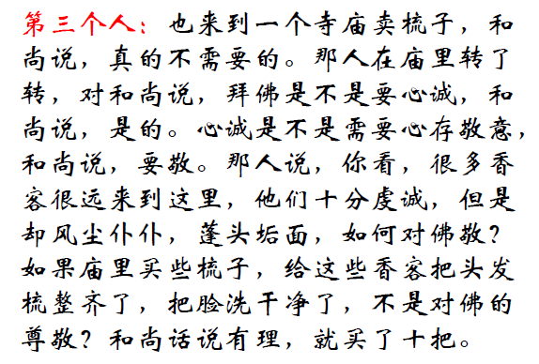
AEM WEEKEND SHARING

Slide 5

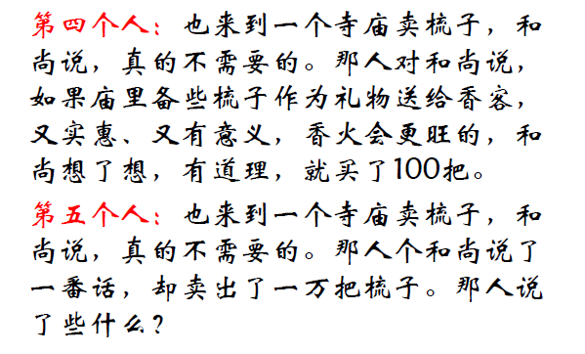
AEM WEEKEND SHARING

Slide 6

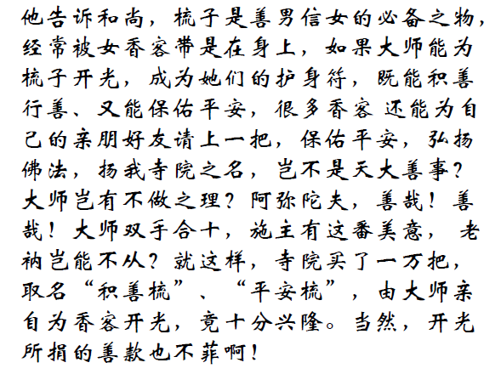
AEM WEEKEND SHARING

Slide 7
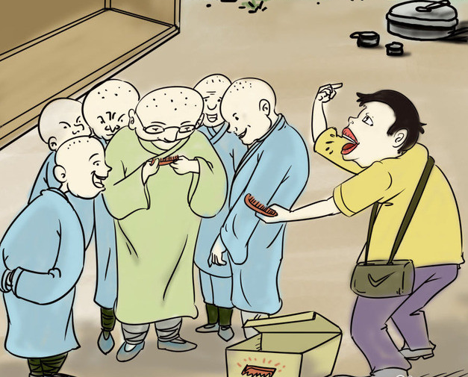
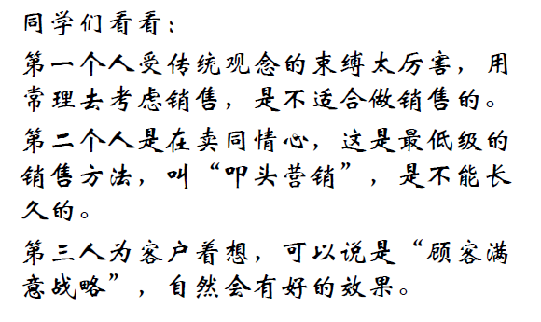
AEM WEEKEND SHARING

Slide 8
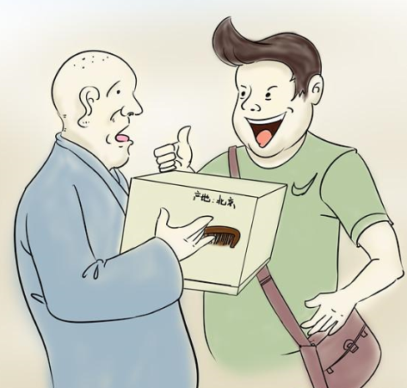
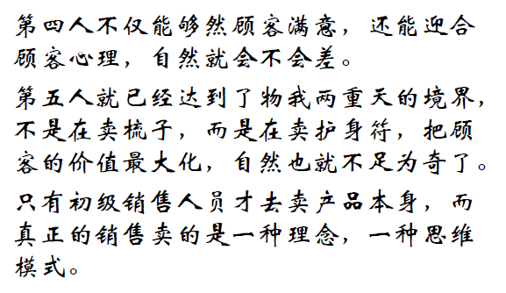
AEM WEEKEND SHARING

Slide 9
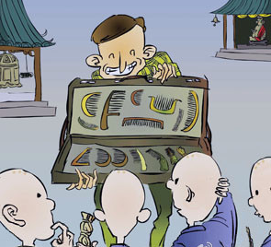
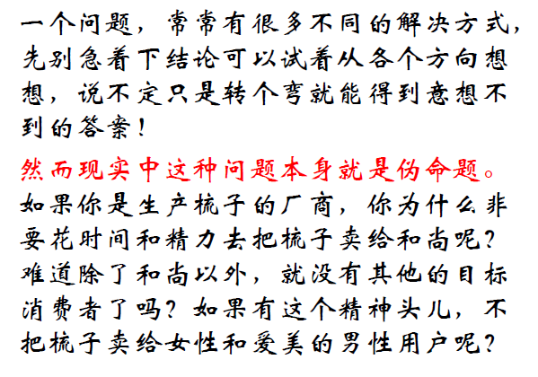
AEM WEEKEND SHARING

Slide 10

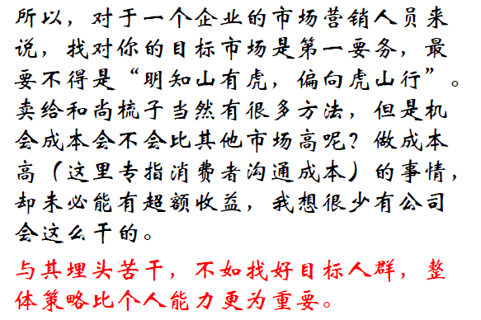
AEM WEEKEND SHARING

Slide 11

AEM WEEKEND SHARING
周末愉快！
共创 共进 共赢 共享
AEM科技人力资源部

