Slide 1


AEM WEEKEND SHARING
AEM周末分享
第 222 期
两点之间真的
直线最短吗？

Slide 2

AEM WEEKEND SHARING

Slide 3

AEM WEEKEND SHARING

Slide 4
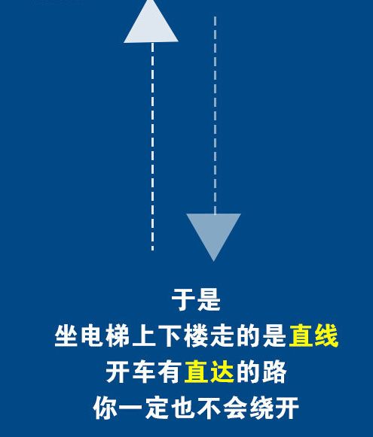
AEM WEEKEND SHARING

Slide 5

AEM WEEKEND SHARING

Slide 6

AEM WEEKEND SHARING

Slide 7

AEM WEEKEND SHARING

Slide 8

AEM WEEKEND SHARING

Slide 9

AEM WEEKEND SHARING

Slide 10

AEM WEEKEND SHARING

Slide 11

AEM WEEKEND SHARING

Slide 12

AEM WEEKEND SHARING

Slide 13

AEM WEEKEND SHARING

Slide 14

AEM WEEKEND SHARING
周末愉快！
共创 共进 共赢 共享
AEM科技人力资源部

