Slide 1


AEM周末分享
第 221期
你还不会和孩子
相处吗？
AEM WEEKEND SHARING

Slide 2

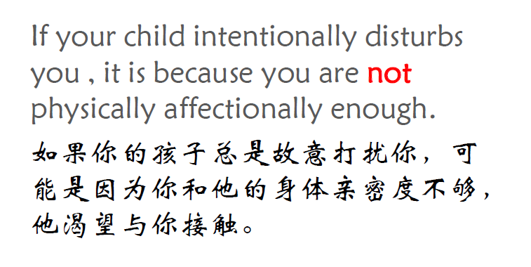
AEM WEEKEND SHARING

Slide 3

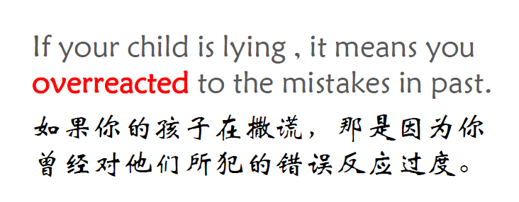
AEM WEEKEND SHARING

Slide 4

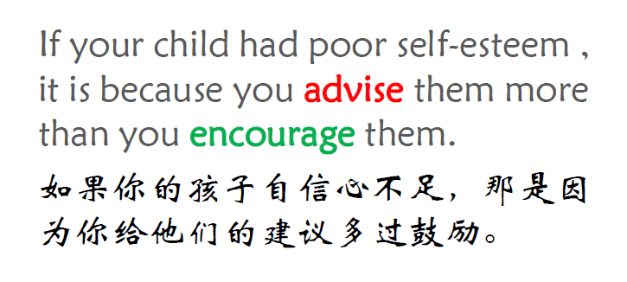
AEM WEEKEND SHARING

Slide 5

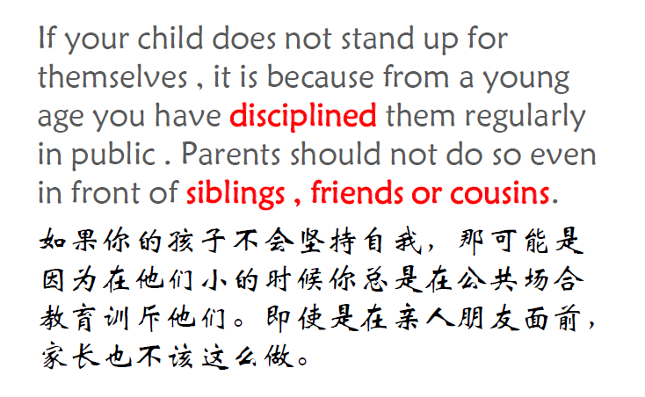
AEM WEEKEND SHARING

Slide 6

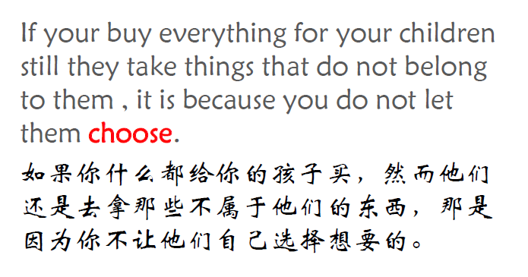
AEM WEEKEND SHARING

Slide 7

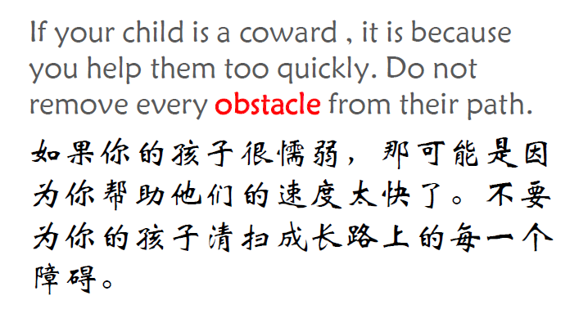
AEM WEEKEND SHARING

Slide 8

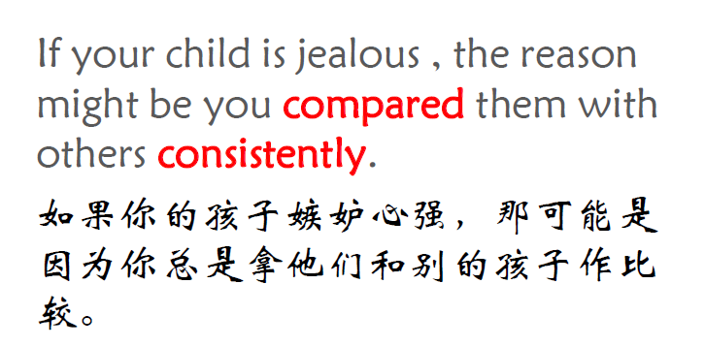
AEM WEEKEND SHARING

Slide 9

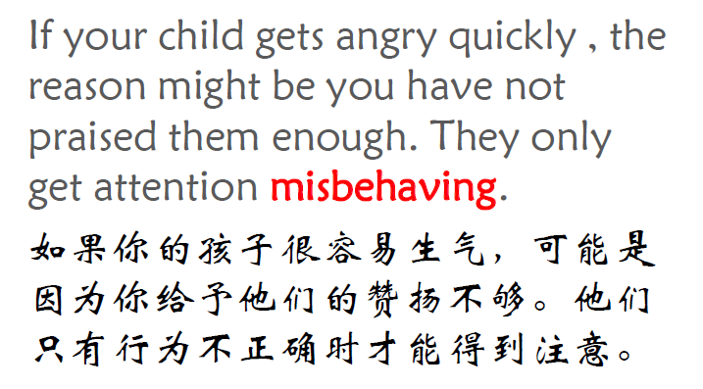
AEM WEEKEND SHARING

Slide 10

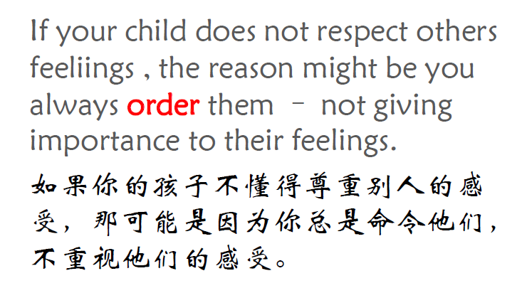
AEM WEEKEND SHARING

Slide 11

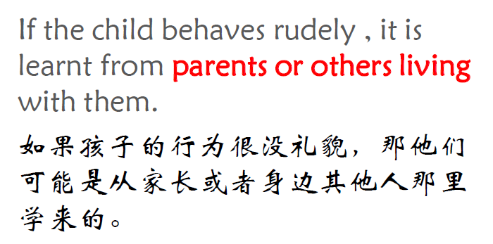
AEM WEEKEND SHARING

Slide 12

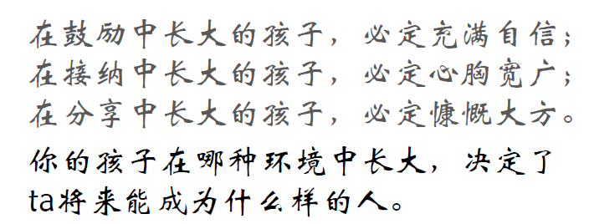
AEM WEEKEND SHARING

Slide 13

周末愉快！
共创 共进 共赢 共享
AEM科技人力资源部
AEM WEEKEND SHARING

