Slide 1


AEM WEEKEND SHARING
AEM周末分享
第 206 期
14个生活小贴士
希望你活得更快乐

Slide 2

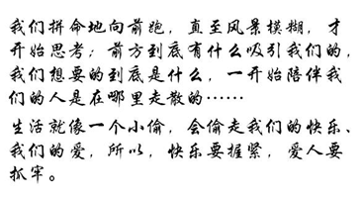
AEM WEEKEND SHARING

Slide 3
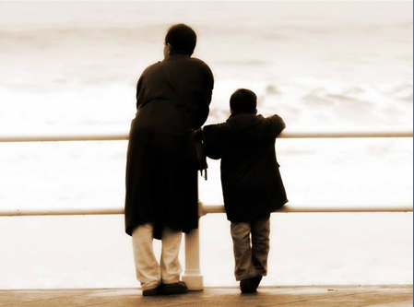
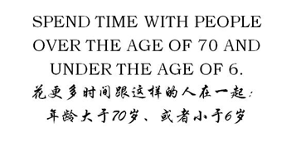
AEM WEEKEND SHARING

Slide 4
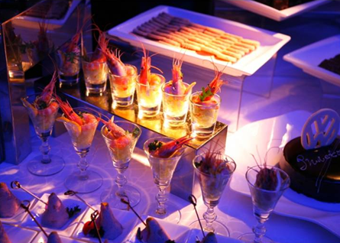
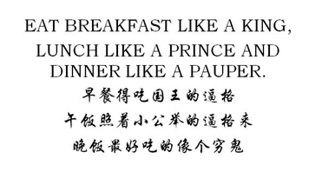
AEM WEEKEND SHARING

Slide 5


AEM WEEKEND SHARING

Slide 6


AEM WEEKEND SHARING

Slide 7

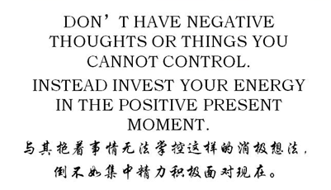
AEM WEEKEND SHARING

Slide 8


AEM WEEKEND SHARING

Slide 9


AEM WEEKEND SHARING

Slide 10

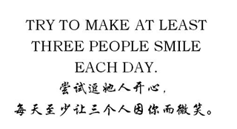
AEM WEEKEND SHARING

Slide 11


AEM WEEKEND SHARING

Slide 12


AEM WEEKEND SHARING

Slide 13


AEM WEEKEND SHARING

Slide 14


AEM WEEKEND SHARING

Slide 15

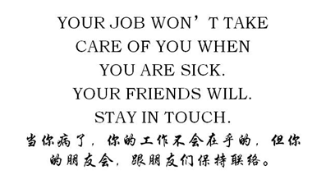
AEM WEEKEND SHARING

Slide 16


AEM WEEKEND SHARING

Slide 17

AEM WEEKEND SHARING
周末愉快！
共创 共进 共赢 共享
AEM科技人力资源部

