Slide 1


AEM周末分享
第140 期
和孩子聊一聊
10个问题
AEM WEEKEND SHARING

Slide 2
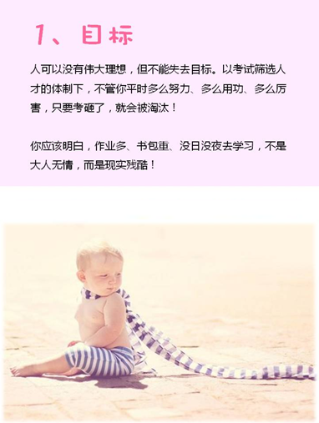
AEM WEEKEND SHARING

Slide 3
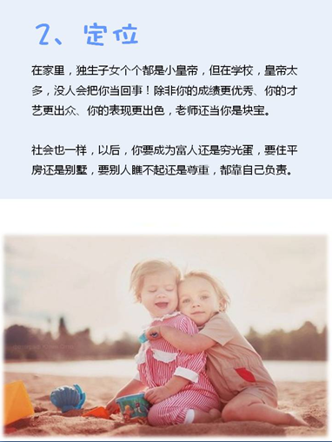
AEM WEEKEND SHARING

Slide 4
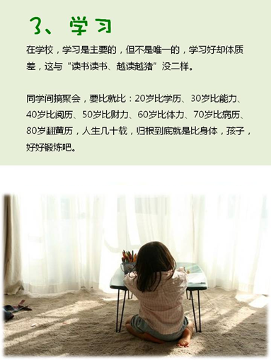
AEM WEEKEND SHARING

Slide 5

AEM WEEKEND SHARING

Slide 6
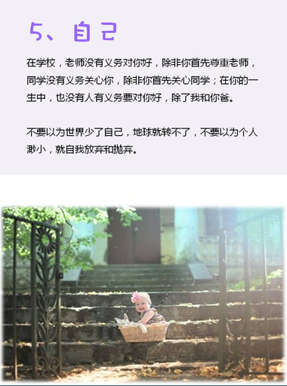
AEM WEEKEND SHARING

Slide 7

AEM WEEKEND SHARING

Slide 8
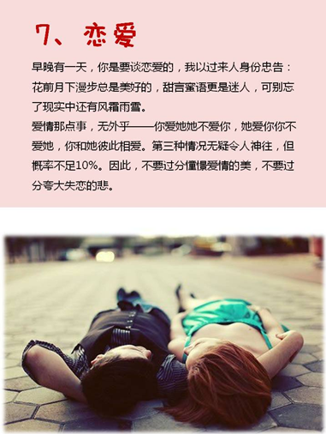
AEM WEEKEND SHARING

Slide 9
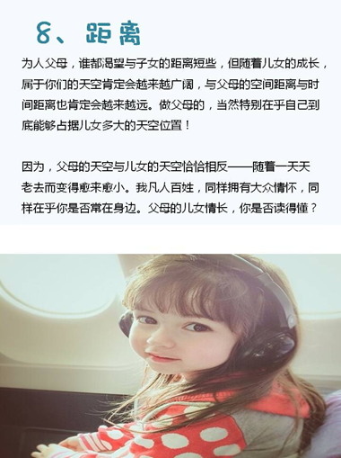
AEM WEEKEND SHARING

Slide 10
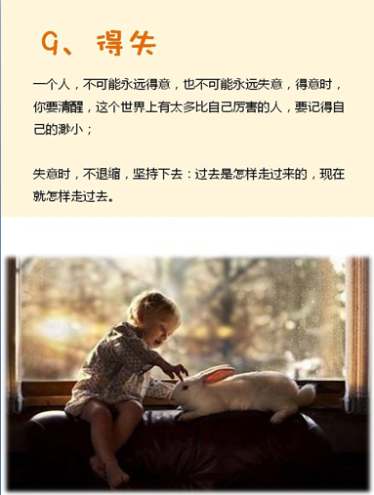
AEM WEEKEND SHARING

Slide 11

AEM WEEKEND SHARING

Slide 12

周末愉快！
共创 共进 共赢 共享
AEM科技人力资源部
AEM WEEKEND SHARING

