Slide 1


AEM WEEKEND SHARING
AEM周末分享
第126期

Slide 2

AEM WEEKEND SHARING

Slide 3

AEM WEEKEND SHARING

Slide 4

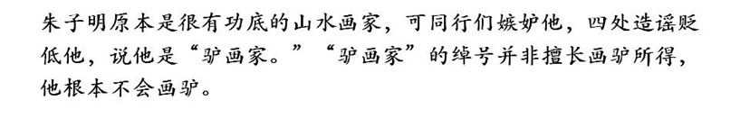
AEM WEEKEND SHARING

Slide 5

AEM WEEKEND SHARING

Slide 6

AEM WEEKEND SHARING

Slide 7
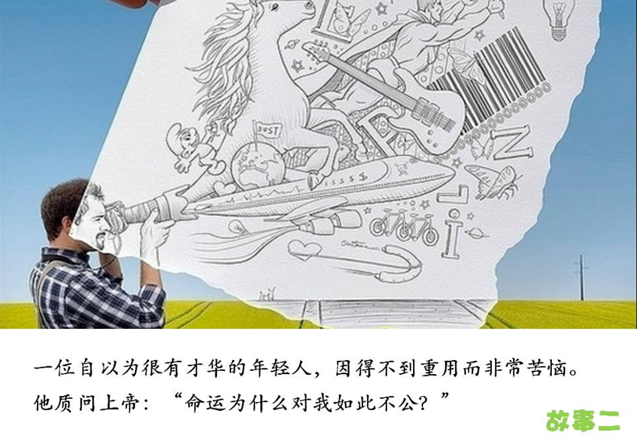
AEM WEEKEND SHARING

Slide 8

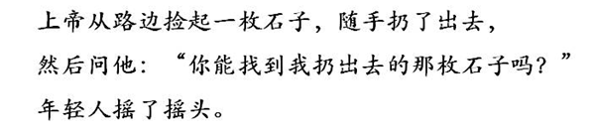
AEM WEEKEND SHARING

Slide 9
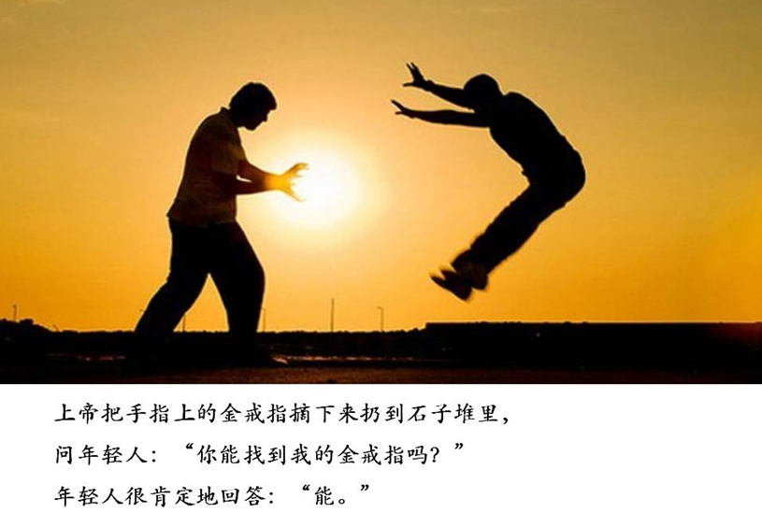
AEM WEEKEND SHARING

Slide 10
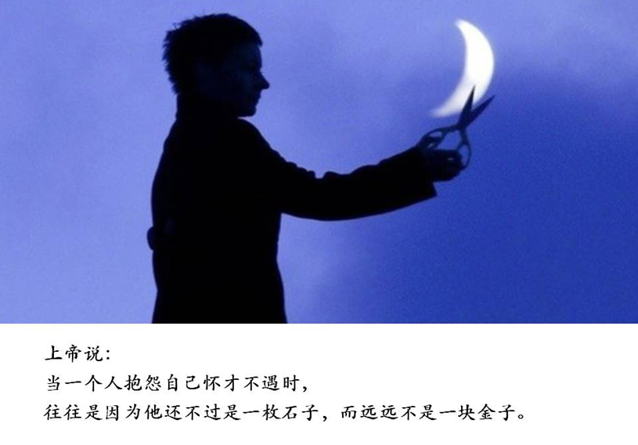
AEM WEEKEND SHARING

Slide 11

AEM WEEKEND SHARING

Slide 12

AEM WEEKEND SHARING

Slide 13

AEM WEEKEND SHARING

Slide 14

AEM WEEKEND SHARING

Slide 15

AEM WEEKEND SHARING

Slide 16

AEM WEEKEND SHARING
这时，一位朋友对他说：你要么驾驭失败，要么让失败驾驭你。你的心态是你真正的主人，它将决定谁是坐骑，谁是骑师。

Slide 17
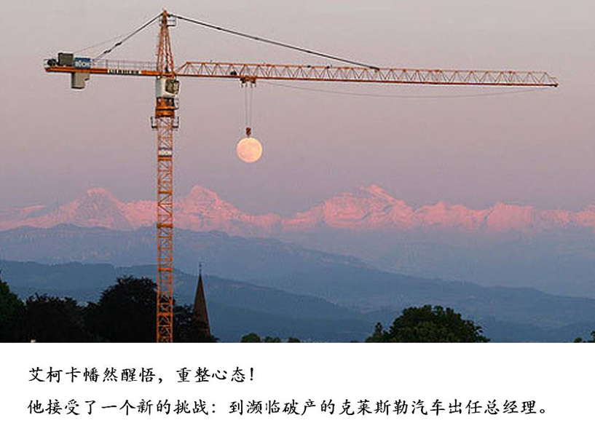
AEM WEEKEND SHARING

Slide 18

AEM WEEKEND SHARING

Slide 19

AEM WEEKEND SHARING

Slide 20
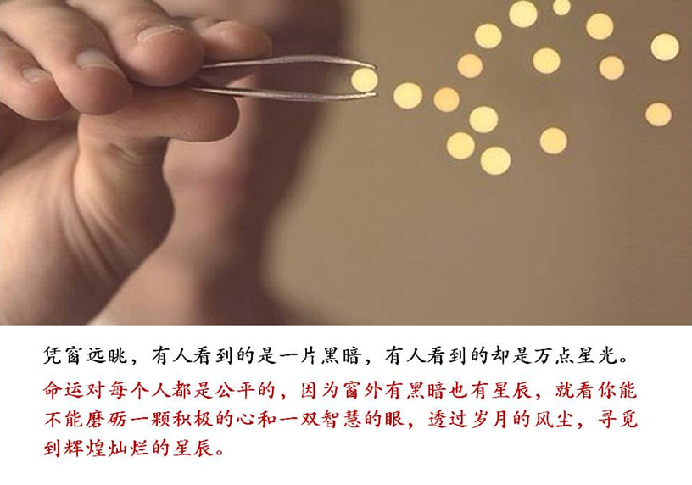
AEM WEEKEND SHARING

Slide 21

AEM WEEKEND SHARING
周末愉快！
共创 共进 共赢 共享
AEM科技人力资源部

